Slide 1

Data exploration and Visualization
Data exploration is the first step in data analysis involving the use of data visualization tools and statistical techniques to uncover data set characteristics and initial patterns.
During exploration, raw data is typically reviewed with a combination of manual workflows and automated data-exploration techniques to visually explore data sets, look for similarities, patterns and outliers and to identify the relationships between different variables.
This is also sometimes referred to as exploratory data analysis, which is a statistical technique employed to analyze raw data sets in search of their broad characteristics.

Slide 2
Why is data exploration important?
Humans are visual learners, able to process visual data much more easily than numerical data. Consequently, it's challenging for data scientists to review thousands of rows of data points and infer meaning without assistance.
Data visualization tools and elements like colors, shapes, lines, graphs and angles aid in effective data exploration of metadata, enabling relationships or anomalies to be detected.

Slide 3
What industries use data exploration?
Any business or industry that collects or utilizes data can benefit from data exploration. A few common industries include software development, healthcare and education.
The advanced visualization techniques employed by data exploration and business intelligence tools enable businesses and stakeholders to better understand performance metrics by making raw data more comprehensible and creating a "story" around it.
By visualizing patterns and finding commonalities in complex data flows, data exploration can help enterprises make data-driven decisions to streamline processes, better target their ideal audience, increase productivity and achieve greater returns.

Slide 4
Data exploration vs. data mining
In data science, there are two primary methods for extracting data from disparate sources: data exploration and data mining.
Data exploration is a broad process that is performed by business users and an increasing numbers of citizen data scientists with no formal training in data science or analytics,whose jobs depend on understanding data trends and patterns.
Visualization tools help this wide-ranging group to better export and examine a variety of metrics and data sets.

Slide 5
Data mining is a specific process, usually undertaken by data professionals.
Typically, data exploration is performed first to assess the relationships between variables. Then the data mining begins.
Through this process, data models are created to gather additional insight from the data.

Slide 6
How machine learning is applied to data exploration
Machine learning can significantly aid in data exploration when large quantities of data are involved. However, for a machine learning model to be accurate, data analysts must take the following steps before performing the analysis:
1. Identify and define all variables in the data set.
2. Conduct univariate analysis for single variables, using a histogram, box plot or scatter plot. For categorical variables (those that can be grouped by category), bar charts can be used.
3. Conduct bivariate analysis, to determine the relationship between pairs of variables. This can be completed using data visualization tools.
4. Account for any missing values and outliers.

Slide 7
What is the best language for data exploration?
The most commonly used statistical methods in data exploration are the R programming language and Python. Both are open source data analytics languages.
While R is best for statistical analysis, Python is better suited for machine learning algorithms.

Slide 8
Steps of Data Exploration and Preparation
The quality of your inputs decide the quality of your output. So, once you have got your business hypothesis ready, it makes sense to spend lot of time and efforts here.
Generally, data exploration, cleaning and preparation can take up to 70% of your total project time

Slide 9
Steps involved for clean and prepare your data for building your predictive model
Variable Identification
Univariate Analysis
Bi-variate Analysis
Missing values treatment
Outlier treatment
Variable transformation
Variable creation

Slide 10
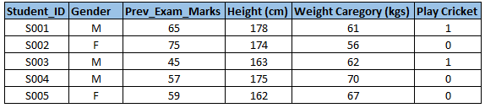
Variable Identification
First, identify Predictor (Input) and Target (output) variables. Next, identify the data type and category of the variables.
Example:- Suppose, we want to predict, whether the students will play cricket or not (refer below data set). Here you need to identify predictor variables, target variable, data type of variables and category of variables.

Slide 11
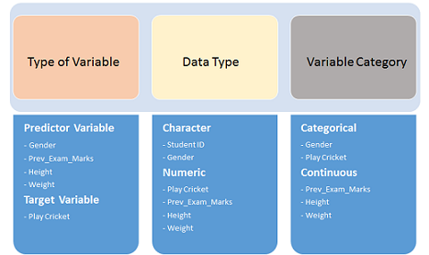
Variable Identification

Slide 12
Univariate Analysis
Method to perform uni-variate analysis will depend on whether the variable type is categorical or continuous.
Continuous Variables:- In case of continuous variables, we need to understand the central tendency and spread of the variable.
Categorical Variables:- For categorical variables, we’ll use frequency table to understand distribution of each category. We can also read as percentage of values under each category. Bar chart can be used as visualization.

Slide 13
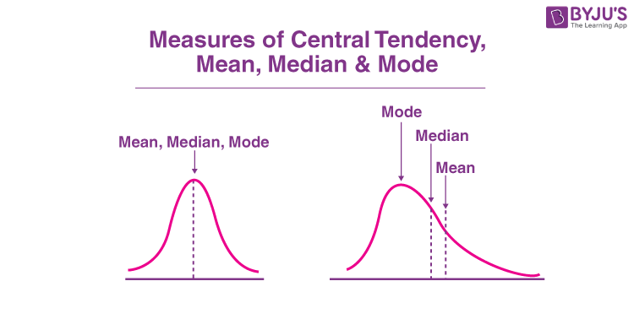
Mean is the most commonly used measure of central tendency. It actually represents the average of the given collection of data. It is applicable for both continuous and discrete data.
Generally median represents the mid-value of the given set of data when arranged in a particular order.
The most frequent number occurring in the data set is known as the mode.

Slide 14
Univariate Data Visualizations With Python
The iris data set contains 3 classes of 50 instances each, where each class refers to a type of iris plant.
The different variables involved in the data set are Sepal Length, Sepal Width, Petal Length, Petal width which is continuous and Variety which is a categorical variable.
Though the data set is multivariate in nature, for univariate analysis, we consider one variable of interest at a time.

Slide 15
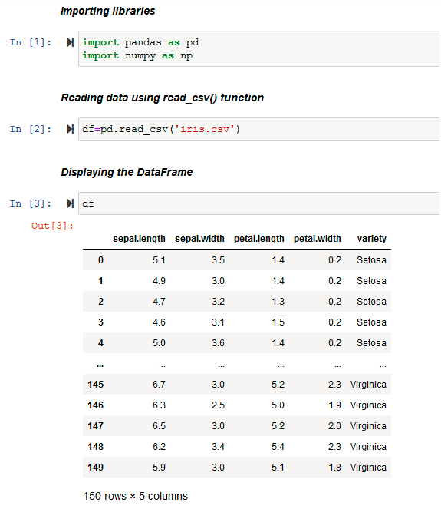

Slide 16
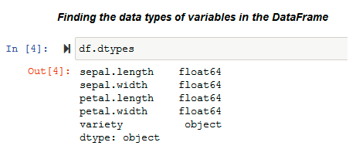

Slide 17
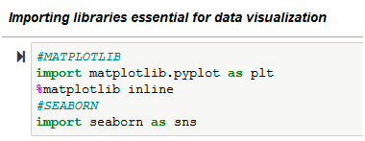

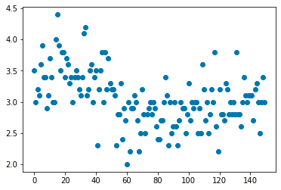

Slide 18
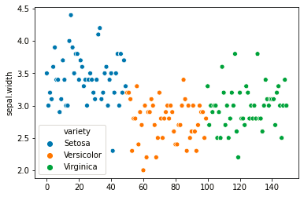

Slide 19
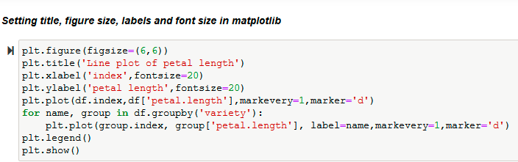
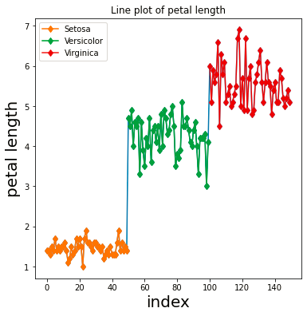
LINE PLOT (with markers) :

Slide 20
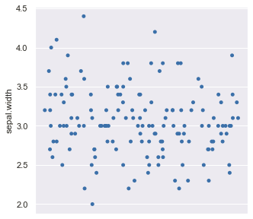
STRIP PLOT :
The strip plot is similar to a scatter plot. It is often used along with other kinds of plots for better analysis. It is used to visualize the distribution of data points of the variable.
The sns.striplot ( ) function is used to plot a strip-plot :

Slide 21
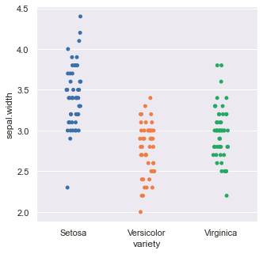

Slide 22
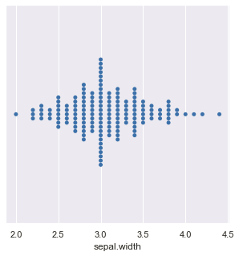

SWARM PLOT :
The swarm-plot, similar to a strip-plot, provides a visualization technique for univariate data to view the spread of values in a continuous variable. The only difference between the strip-plot and the swarm-plot is that the swarm-plot spreads out the data points of the variable automatically to avoid overlap and hence provides a better visual overview of the data.

Slide 23
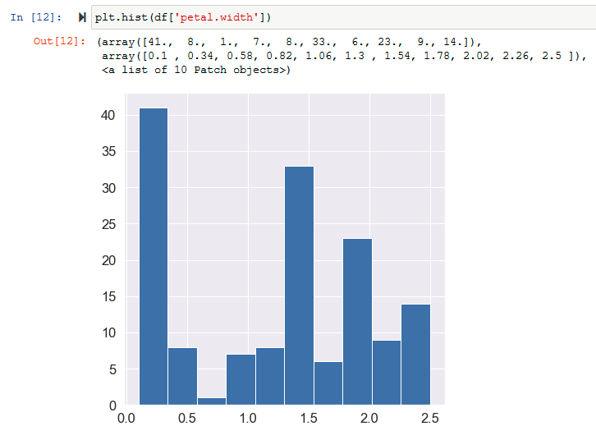
HISTOGRAMS :
Histograms are similar to bar charts which display the counts or relative frequencies of values falling in different class intervals or ranges.
A histogram displays the shape and spread of continuous sample data. It also helps us understand the skewness and kurtosis of the distribution of the data.

Slide 24
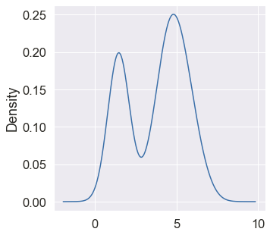

DENSITY PLOTS :
A density plot is like a smoother version of a histogram. Generally, the kernel density estimate is used in density plots to show the probability density function of the variable. A continuous curve, which is the kernel is drawn to generate a smooth density estimation for the whole data.
Plotting density plot of the variable ‘petal.length’ :

Slide 25
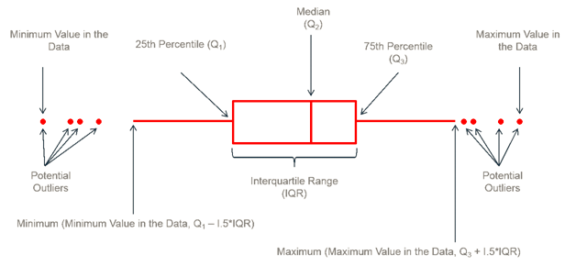
BOX PLOTS :
A box-plot is a very useful and standardized way of displaying the distribution of data based on a five-number summary (minimum, first quartile, second quartile(median), third quartile, maximum). It helps in understanding these parameters of the distribution of data and is extremely helpful in detecting outliers.

Slide 26
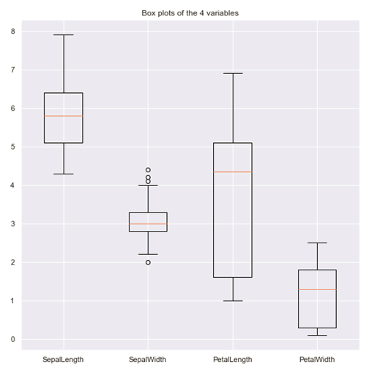
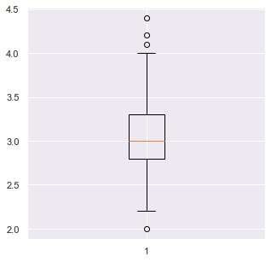


Slide 27

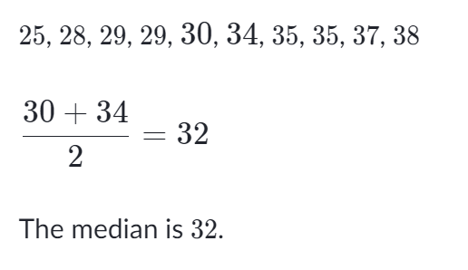
Example: Finding the five-number summary
A sample of 10 boxes of raisins has these weights (in grams):
Step 1: Order the data from smallest to largest.
Our data is already in order.
Step 2: Find the median.
The median is the mean of the middle two numbers:

Slide 28
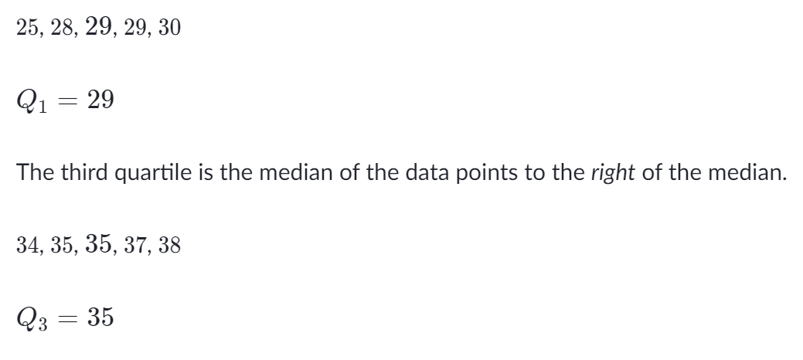
Step 3: Find the quartiles.
The first quartile is the median of the data points to the left of the median.

Slide 29
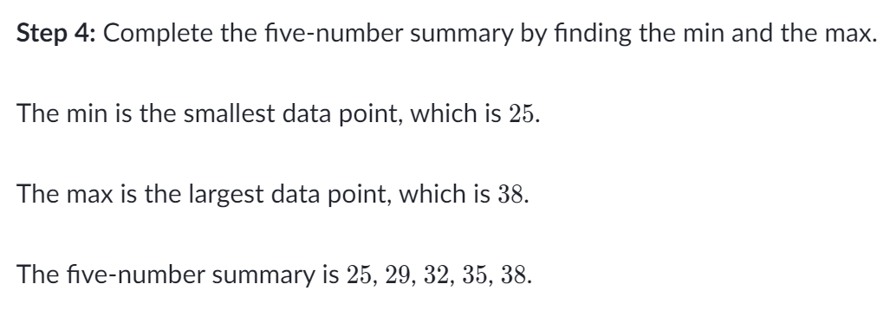
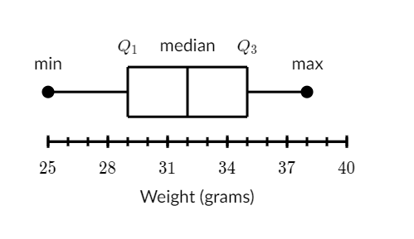

Slide 30
Bi-variate Analysis
Bi-variate Analysis finds out the relationship between two variables.
Here, we look for association and disassociation between variables at a pre-defined significance level.
We can perform bi-variate analysis for any combination of categorical and continuous variables.
The combination can be: Categorical & Categorical, Categorical & Continuous and Continuous & Continuous.

Slide 31
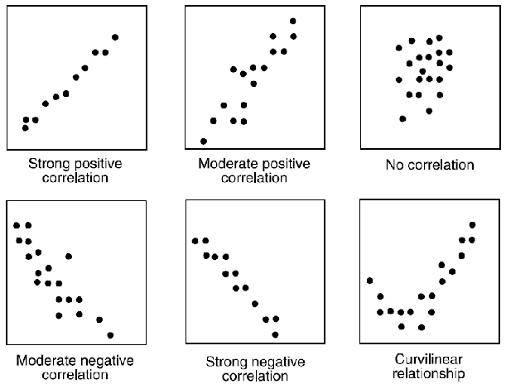
Bi-variate Analysis
Correlation = Covariance(X,Y) / SQRT( Var(X)* Var(Y))

Slide 32
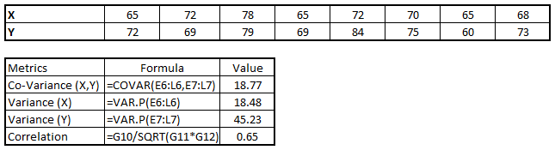
we have good positive relationship(0.65) between two variables X and Y.

Slide 33
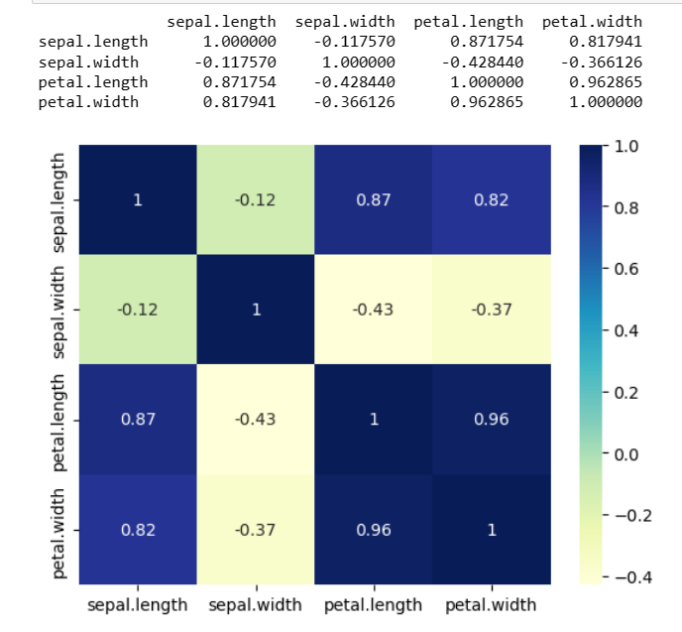
Heatmap
import matplotlib.pyplot as plt
import pandas as pd
import seaborn as sb
data = pd.read_csv('iris.csv')
print(data.corr())
dataplot = sb.heatmap(data.corr(), cmap="YlGnBu", annot=True)
mp.show()

Slide 34
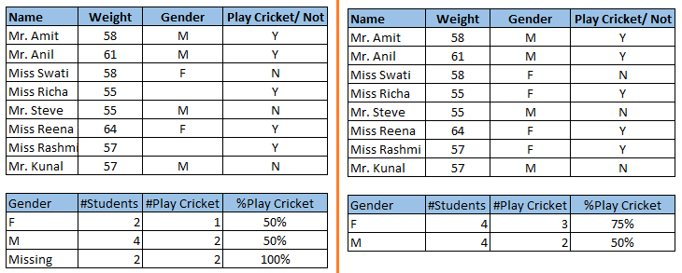
Missing Value Treatment
Missing data in the training data set can reduce the power / fit of a model or can lead to a biased model because we have not analysed the behavior and relationship with other variables correctly.
It can lead to wrong prediction or classification.

Slide 35
Techniques of Outlier Detection and Treatment
What is an Outlier?
Outlier is a commonly used terminology by analysts and data scientists as it needs close attention else it can result in wildly wrong estimations.
Outlier is an observation that appears far away and diverges from an overall pattern in a sample.

Slide 36
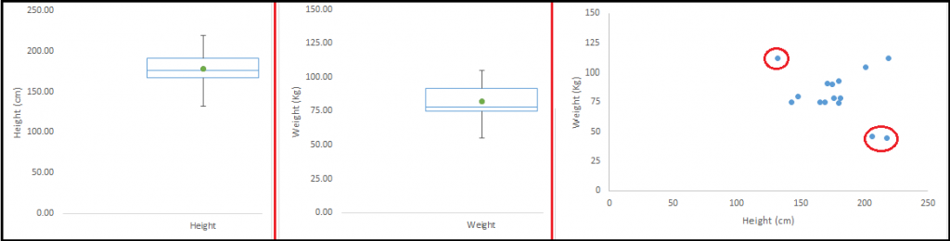
The relationship between height and weight. We have univariate and bivariate distribution for Height, Weight.
Take a look at the box plot. We do not have any outlier. Now look at the scatter plot. Here, we have two values below and one above the average in a specific segment of weight and height.

Slide 37
What causes Outliers?
Artificial (Error) / Non-natural
Natural
Data Entry Errors:
Measurement Error:
Experimental Error:
Data Processing Error:
Data Processing Error:
Natural Outlier:

Slide 38
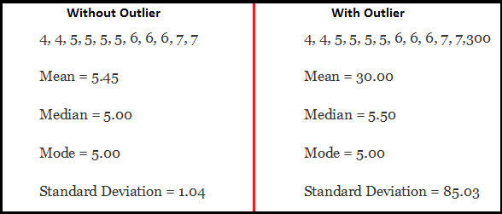
What is the impact of Outliers on a dataset?

Slide 39
How to detect Outliers?
Most commonly used method to detect outliers is visualization. We use various visualization methods, like Box-plot, Histogram, Scatter Plot (above, we have used box plot and scatter plot for visualization).
How to remove Outliers?
Deleting observations: We delete outlier values if it is due to data entry error, data processing error or outlier observations are very small in numbers. We can also use trimming at both ends to remove outliers.
Transforming and binning values: Transforming variables can also eliminate outliers. Natural log of a value reduces the variation caused by extreme values.
Binning is also a form of variable transformation.

Slide 40
